Slide 1
Welcome to Reception
September
2019
With Miss Dunlavy

Slide 2
Welcome to Acomb First School
This presentation aims to provide you an introduction to Reception at Acomb First School and includes information that I hope you will find useful!
School Vision:
Our vision for Acomb First School is to achieve the best quality education providing a culture of learning and discovery for all our children, in a caring and stimulating environment.
We treat all children as individuals, valuing their talents and interests and celebrating all achievements along the way.

Slide 3
About me!
My name is Lauren Dunlavy, I’m 25 and last year was my first year at Acomb First School. Previously I have worked at a summer camp in America, a nursery and also worked as a supply teacher/ teaching assistant in range of schools and year groups, but Reception has always been my favourite!
I hope that if you have any questions or worries you feel you can come to me and I will try and give you the best answer possible.

Slide 4
Welcome to Reception.
Timetable for Autumn Term 1
This is not what a typical week in Reception will look like at the beginning of term! Over the first half term (September - October) we will build up to a timetable that looks something a little like this. The children will have Phonics and Maths adult input every day (no more than 20 minutes sat on the carpet at one time) and opportunities to free flow both in indoor and outdoor provision throughout the day. Time spent on the carpet will be built up over time when the children are ready for it.

Slide 5
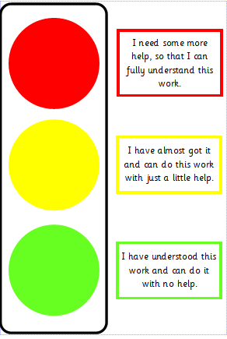
Life in Reception
During your child’s time in Reception, they will..
Enjoy coming to school and learning (hopefully!)
Be encouraged to become more independent as they move towards more formal working.
Learn through play and hands-on activities or discussions.
Cover a variety of areas of learning (including understanding the world around them and art)
Move towards End of Year Expectations which are known as Early Learning Goals.
Complete baseline and end of year assessments.

Slide 6
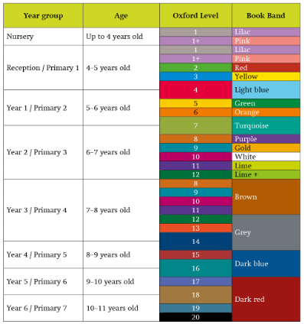
Reading
At the beginning of the year, children will be sent home with books that have no words. These are for the children to gain a solid understanding of how a book works and improve their comprehension.
Eventually your child will be sent home with 3 reading books each week
Book 1- A Book that matches the sounds (where possible) they are learning in school (RWINC phonics book or similar) this will support the decoding aspect of reading.
Book 2 – A book that helps build fluency and expression (Oxford Reading Tree story book or similar or a non-fiction book)
Book 3 – Children’s free choice/library book- This book is to support the enjoyment of reading by sharing a book with a family member at home. This may be a book that your child can’t read yet, or it may be a book that is really easy for your child to read, but they really enjoy. It could be a non-fiction book, a poetry book or their favourite children’s book. This book is purely for the enjoyment of reading and can be read aloud to your child.
These books will only be changed if the reading record entry is signed by an adult (every Monday).
It is important that you read with your child as often as possible, 5 minutes a night makes a huge difference!

Slide 7
Reading
d a d
Green words are words that your child can sound out phonetically (using their sounds) in order to read them.
Reception end of year expectations.
Children read and understand simple sentences.
They use phonic knowledge to decode regular words and read them aloud accurately.
They read some common irregular words. (tricky red words)
They demonstrate understanding when talking with others about what they have read.
s h e
Tricky/Red words are words that your child cannot sound out phonetically (using their sounds) in order to read them as they don’t sound the same when they are said.
We will learn a new tricky word each week (mostly!) and I will send home the tricky word flash cards for you to practice recognising these with your child.
Your child will be expected to read these words on sight by the end of Reception.

Slide 8
Writing
By the end of Reception, your child should be able to write sentences independently that are phonetically plausible – that doesn’t mean everything spelt correctly! For example, I eet bred. (I eat bread). The children will learn alternate spellings for different sounds at later points in the year ( for example, u and oo both make the same sound) and will start to make the choice of which spelling is correct. However, as long as the children use the sounds that they have learnt so far in the year to spell, they should reach the Early Learning Goal.
Children are also expected to be able to spell some tricky red words in their writing and will be taught the spelling of these in our phonics lessons.
Please encourage your child to use their phonics knowledge whenever they are writing, even if it looks like gobbledegook!
Reception End of Year Expectations
Children use their phonic knowledge to write words in ways which match their spoken sounds.
They also write some irregular common words.
They write simple sentences which can be read by themselves and others.
Some words are spelt correctly and others are phonetically plausible.

Slide 9
Phonics
How to pronounce the sounds!
https://www.youtube.com/watch?v=TkXcabDUg7Q
Reception are taught Phonics every morning. We will start with set 1 sounds at the beginning of the year, doing one sound a day and reviewing on a Friday. During their Phonics lessons the children will be taught to recognise and write the sound using the correct formation (using the rhymes shown opposite). They will also be taught how to blend (joining the sounds together to make a word) when reading and to segment (pick out the sounds they can hear in a word, e.g. d- o –g ) when spelling.

Slide 10
Maths
Maths is split into two main sections – Number and Shape, Space and Measure.
In Reception, children will work primarily with concrete objects in order to gain a solid understanding of the concepts taught. They will move onto pictorial and abstract representations of these concepts when they are ready.
Maths is taught in a fun and practical way in order to keep the children engaged. They will work individually, in pairs or as part of a group and will be encouraged to have lots of discussions using mathematical language and reasoning skills.
We will be focussing on one number a week and incorporating other elements into that week of learning. For example, when doing the number 5, we will look at number bonds to 5, pentagons, etc. This ensures the children have a real in-depth knowledge of the number we are working on.
Reception End of Year Expectations
Children count reliably with numbers from one to 20.
Children can put numbers 1-20 in order.
Children can say which number is one more or less than a given number.
Using quantities and objects, they add and subtract two single-digit numbers and count on or back to find the answer.
They solve problems, including doubling, halving and sharing.
Children use everyday language to talk about size, weight, capacity, position, distance, time and money to compare quantities and objects and to solve problems.
They recognise, create and describe patterns.
They explore characteristics of everyday objects and shapes and use mathematical language to describe them.

Slide 11
Other areas of learning
The next two slides are to show you other areas of the curriculum that the children will cover and the main learning goals in each area.
These other areas of learning will be taught in a range of ways. Children will take part in adult led sessions each week, however, they will also be covered during free flow and child-initiated time when myself and Miss Eames will work alongside them, question them and extend their thinking.

Slide 12
Personal, Social and Emotional Development (PSED)
PSED is split into 3 areas of learning
Self confidence
When speaking in class
Evaluating things they like/don’t like and things they’d like to try.
Asking for help
Managing Feelings and Behaviour
Understanding feelings
being able to control their behaviour
knowing when and how to stand up for themselves appropriately.
Communication and Language
C&L is also split into 3 areas of learning.
Listening and Attention
Listening to and following instructions
Listening in a large group
Listening and responding to stories
Understanding
Follow instructions involving more than one action.
Answer how and why questions
Speaking
-express themselves effectively, using past and present forms of speech
-develop own narratives and explanations
Physical Development
PD is split into 2 areas of learning
Moving and Handling
Show good control in large and small movements (including writing)
Move with confidence and skill in a range of ways
Handle equipment and tools effectively
Health and Self-Care
Understanding the importance of healthy eating, exercise and keeping safe.
Manage own basic hygiene including toileting, dressing and undressing independently.

Slide 13
Expressive Arts and Design
EAD is split into 2 areas of learning
Exploring & using media and materials.
Sing songs, make music and dance.
Safely use and explore materials and tools
Being Imaginative
- representing their own ideas
- Using media and materials in original ways
Understanding the World
UTW is split into 3 areas of learning
People & Communities
Talk about past and present events in their own lives/lives of family members.
Understanding that not everyone likes the same things as them.
They recognise similarities and differences between themselves and others.
The World
- recognising similarities and differences in relation to places, objects, materials and living things.
- make observations of animals and plants and explain why some things happen.
Technology
Recognise that technology is used in a range of different places.
-use technology for different purposes.

Slide 14
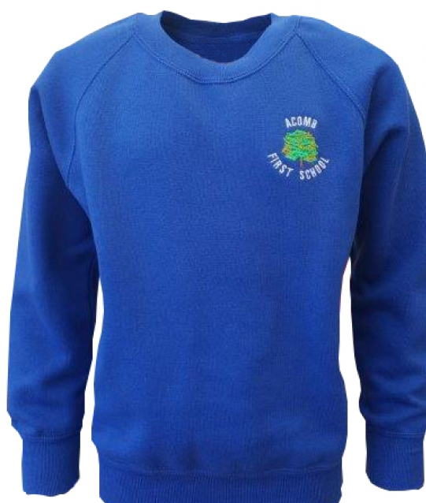
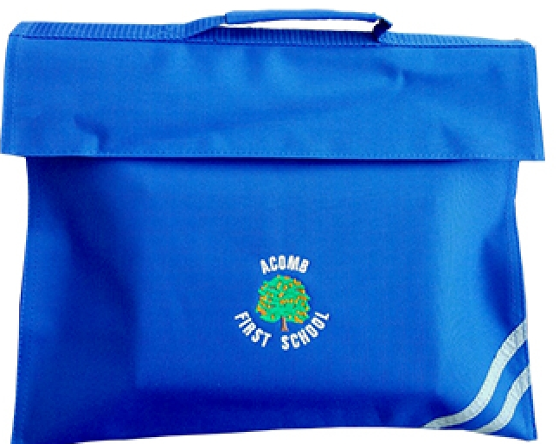
Just a reminder!
PE- Thursday and Friday:
The children need to come to school in their PE kit and trainers or sandshoes on the days they have PE. They need their blue shorts, white T shirts and joggers and sweatshirt or fleece top so they are prepared for indoor or outdoor PE all year. Please still name all of your child’s clothing as no doubt, it will manage to go walkabout!
Forest school – Wednesday pm with Anna Gray.
The children need to wear warm clothes to go underneath their waterproofs for forest school. This includes a long sleeve top and sweatshirt, warm socks, joggers or leggings, hat scarves and gloves etc. They will also need to bring wellies in a bag (if they have them). Mrs Gray will be taking the children to Forest School every Wednesday afternoon with Miss Eames in almost every weather condition so pleases make sure your child is prepared for all eventualities!
Please remember to send a named water bottle into school as the children are encouraged to drink water throughout the day.
Please remember to name all items of uniform so that any lost items of clothing can be returned to their rightful owner!

Slide 15
How can I help?
Independence
We want to encourage our children to be as independent as possible. Encouraging your chid to dress themselves on their own in the morning, putting their own coat on, carrying their own belongings, washing hands, etc is a really great way of helping your child to be ready for school.
Reading
Read everything! Reading is one of the most important skills that your child will learn in Reception. Books are for enjoyment, as well as learning, so encourage reading as much as you can. Talk about what they’ve read, ask opinions, make predictions, visit the library. Reading doesn’t just have to be the books we send home.
Tapestry!
Tapestry is a great way of communicating with me. If your child has done anything they’d like to share, pop it on Tapestry and we can have a look at it together.
Feel free to come and see me before or after school, I’ll always be around!

Slide 16
Thank You!
Have you got any Questions?
Don’t forgot that the school website http://www.acomb.northumberland.sch.uk/ is kept up to date with the latest news and events and has lots more information about our school.

